Slide 1
Counting Sheep
Presentation 2
Maclean Frazier, Walt Brady, Amir Sadiev, Imran Ahmed

Slide 2
Database Subsystem
Design Perspective
The system will use a mySQL database to take advantage of a relational database as many objects throughout the rest of the system interact with each other.
Analysis Perspective
The database will be hosted on Google’s Cloud SQL platform, to allow multiple users to access the database quickly.
The mySQL database will take advantage of the indexing feature of mySQL, which speeds up querying time to prevent slowing the whole system down.

Slide 3
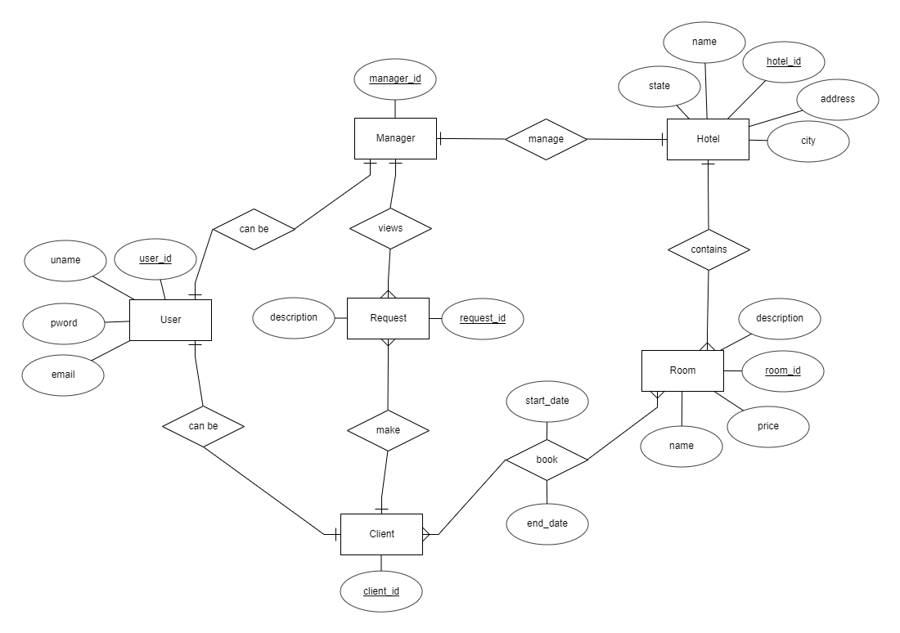
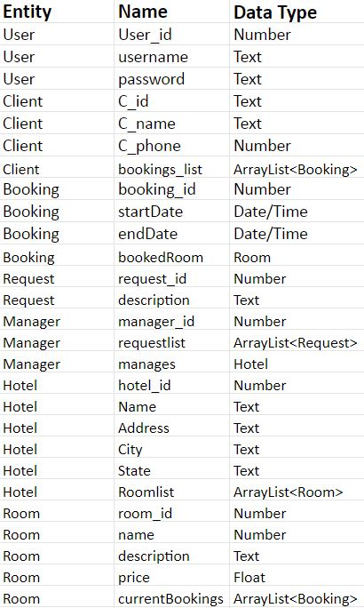

Slide 4
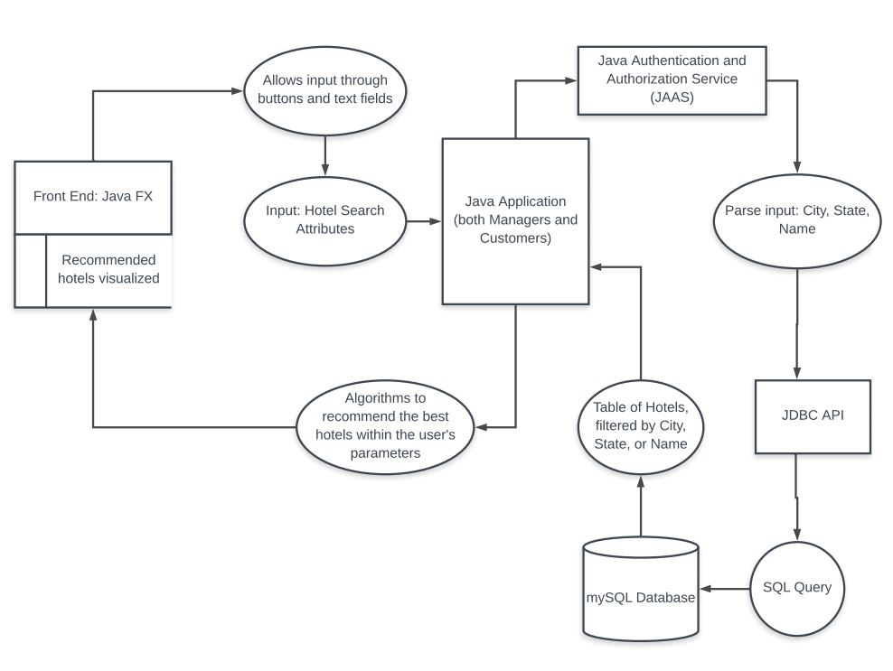

Slide 5
Manager Subsystem
Design Perspective
The manager side, much like the customer subsystem, will be managed using Java. The subsystem will be designed to offer different services from the customer side, and will be linked to the database via room management. We are using java since it allows the creation of objects such as rooms and hotels that the manager will be able to easily manipulate through drop-down menus and text entry.
Analysis Perspective
The manager will mostly be a series of setters and getters that refer to the database. This will be used by the manager of a given hotel, and be used by them to adjust prices and add rooms to the database.

Slide 6
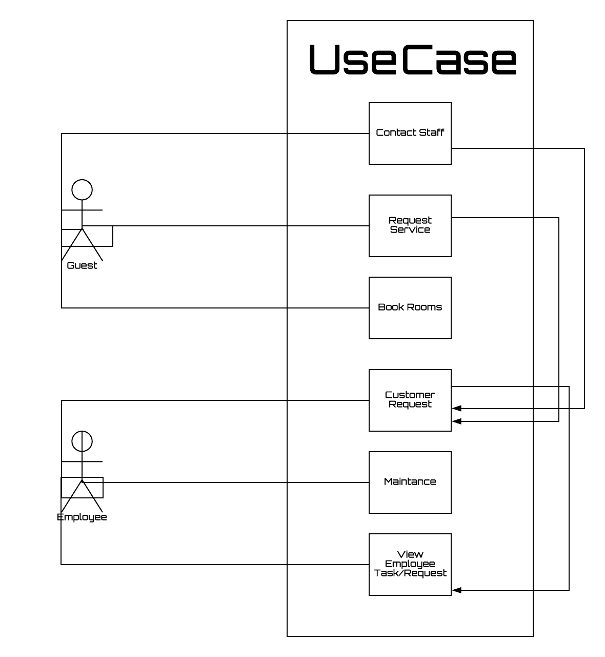

Slide 7
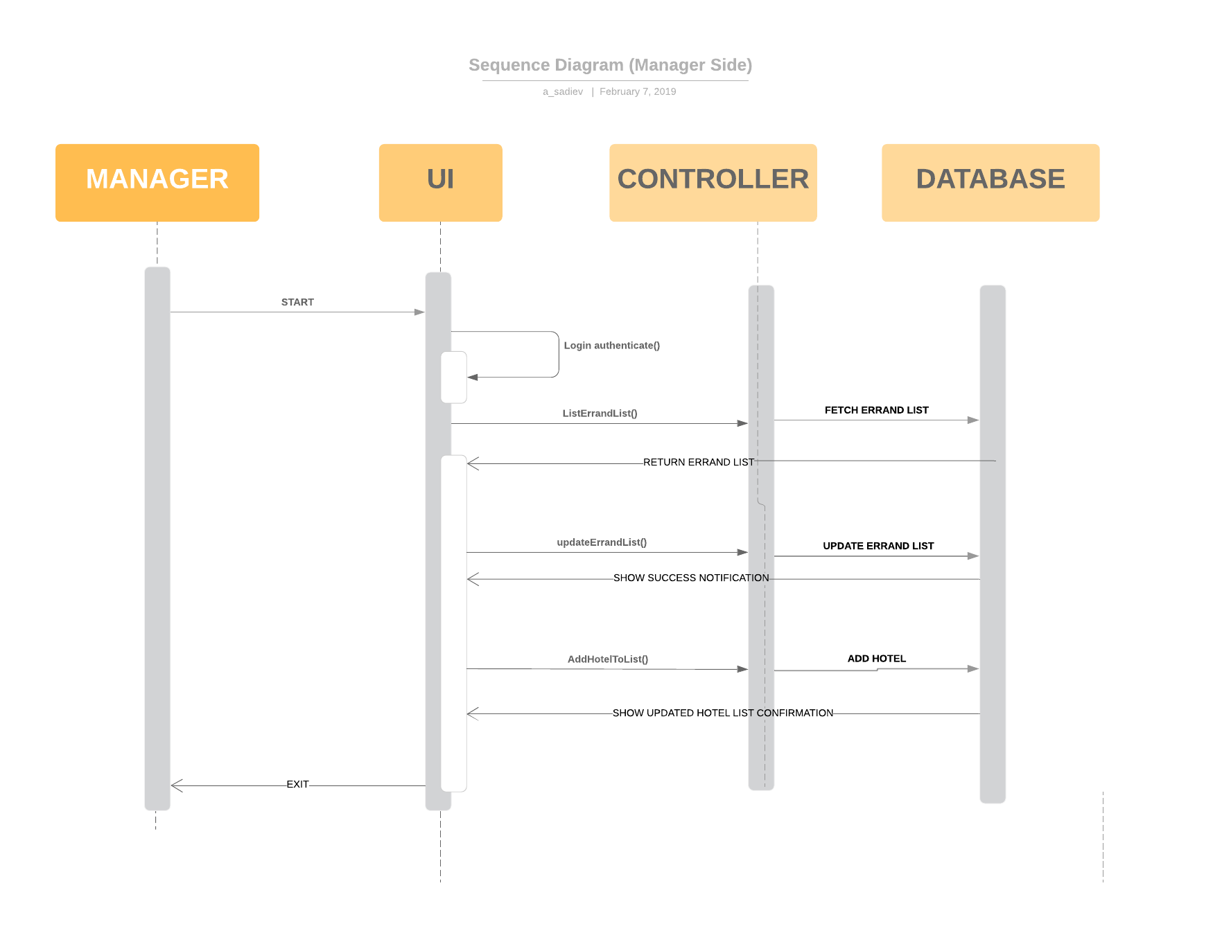

Slide 8
Client Subsystem
Design Perspective
Client side will use the UI to send requests such as choose date of bookings, list available hotels, as well as book rooms. These processes will send requests to the server for the respective information. Once processes are fully finished, the client will see a notification (confirmation) of completion. The whole project is based around Java language, Java FX (GUI) and mySQL database.
Analysis Perspective
Customer will be sending requests to the database via GUI. The program will allow the clients to choose the hotel, dates, and provide optional feedback. The process should be quick-working and intuitive.

Slide 9
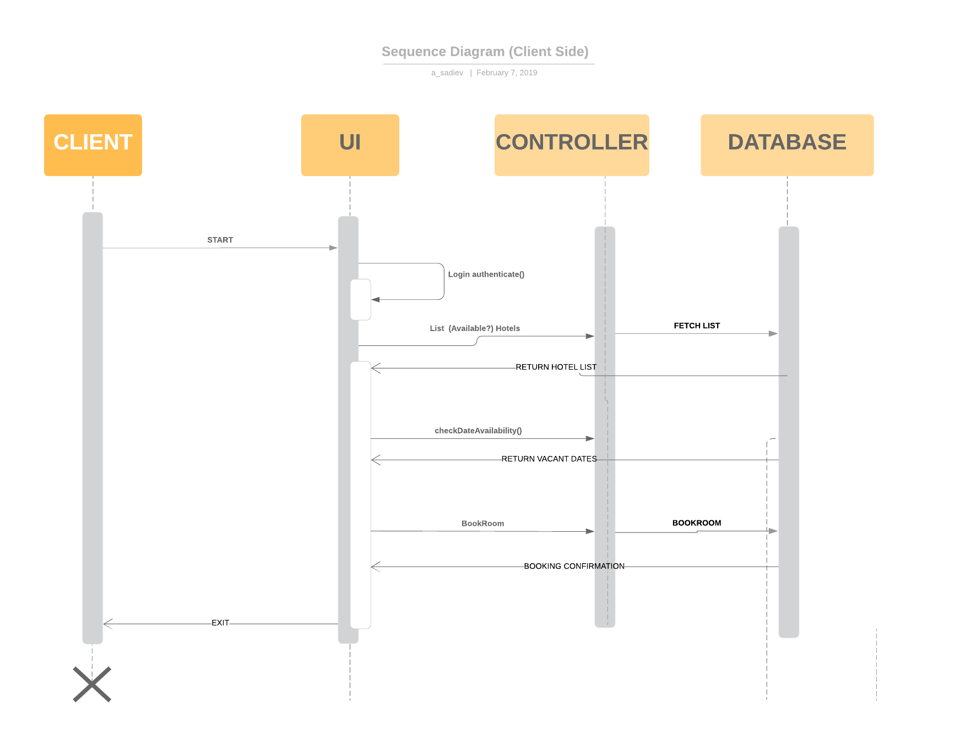

Slide 10
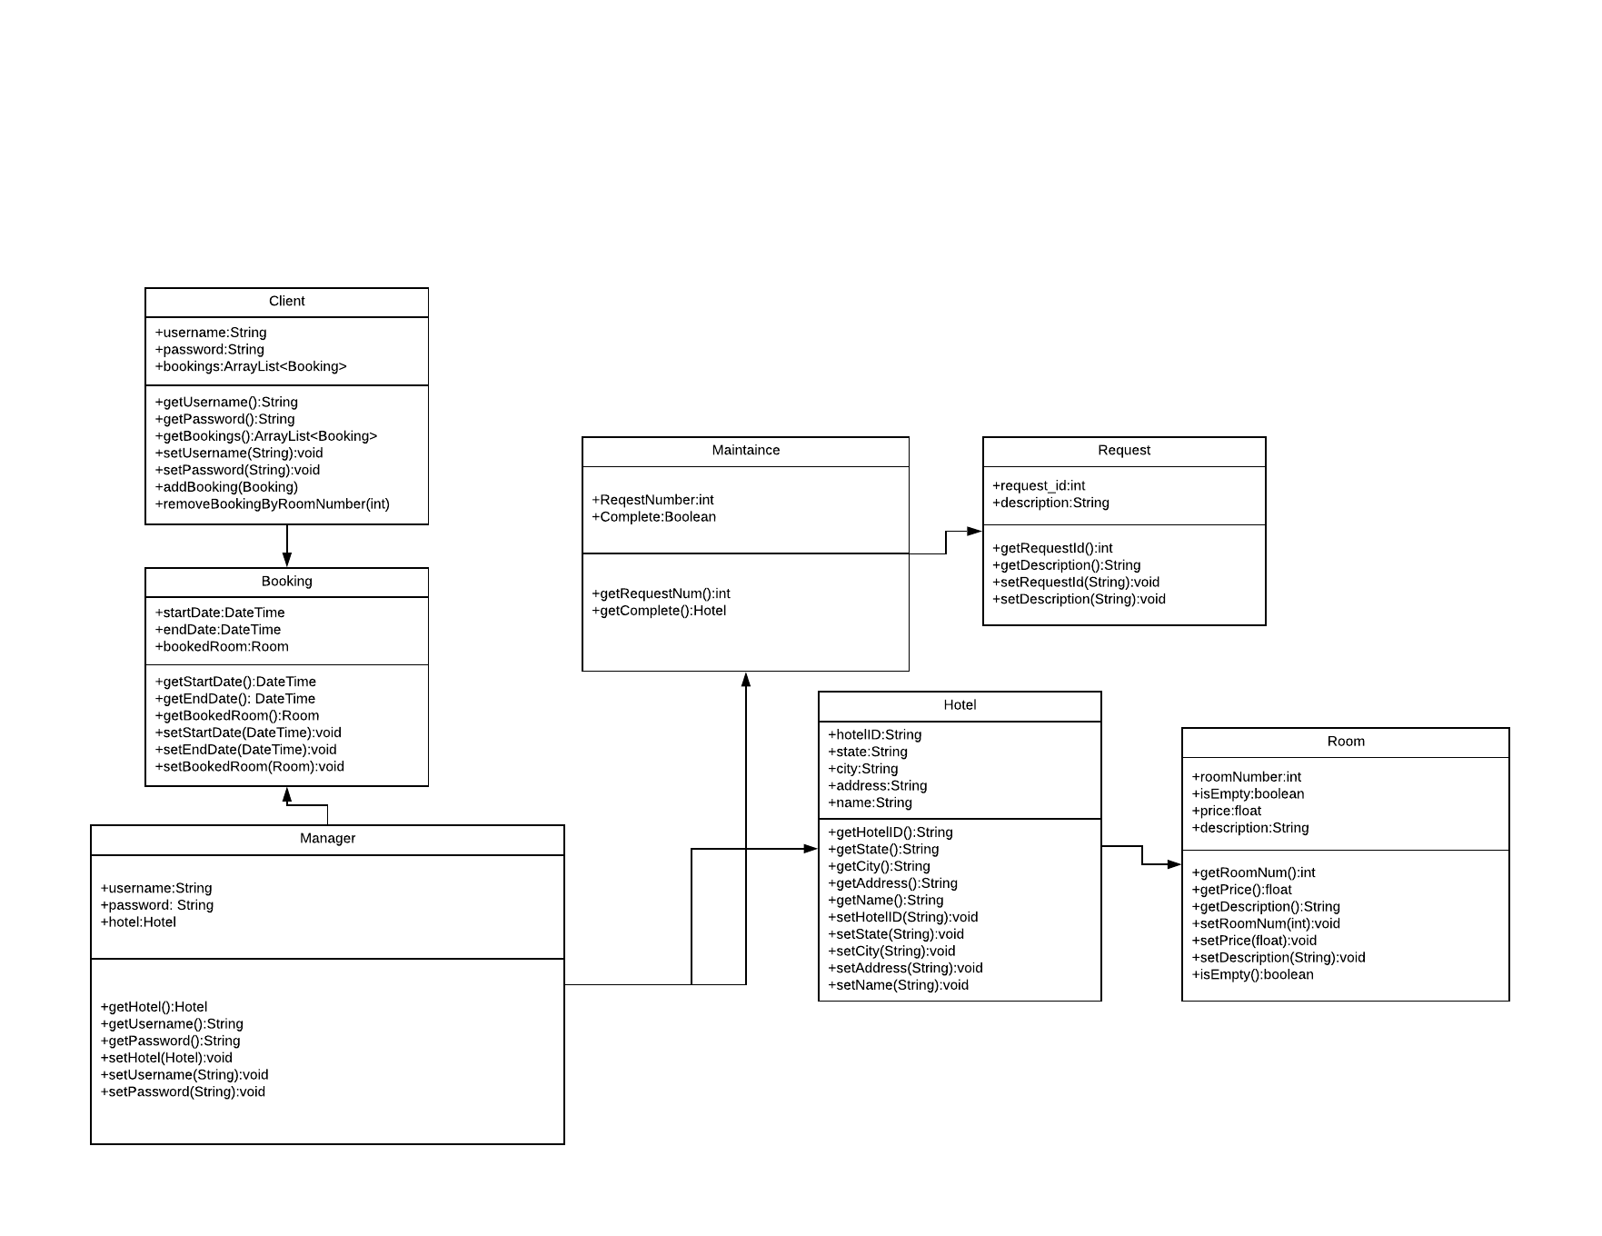

Slide 11
Big O Analysis
GUI
O(1)
Database
Database query time is O(log(n)).
Customer
O(log(n))
Manager
O(log(n)) thanks to the database searches.

